Slide 1
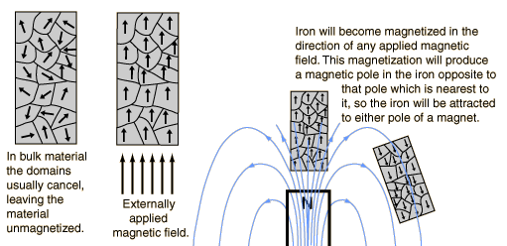
Magnetic domains

Slide 2



Electric and magnetic constants
In the equations describing electric and magnetic fields and their propagation, three constants are normally used:
the speed of light c
The electric permittivity of free space ε₀
the magnetic permeability of free space, μ₀, taken to have the exact value
Contains the force unit N for Newton and the unit A is the Ampere, the unit of electric current.
With the magnetic permeability established, the electric permittivity takes the value given by the relationship
Give a value of free space permittivity
In practice used in the form
Expressions contain the units F for Farad, the unit of capacitance, and C for Coulomb, the unit of electric charge.

Slide 3
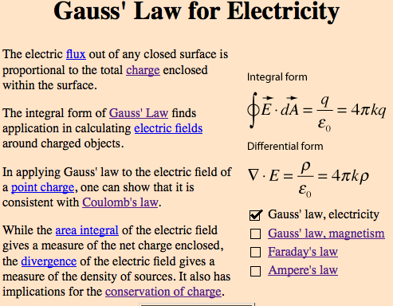

Slide 4
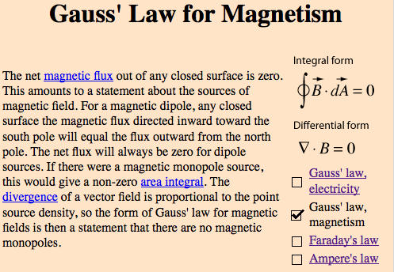

Slide 5
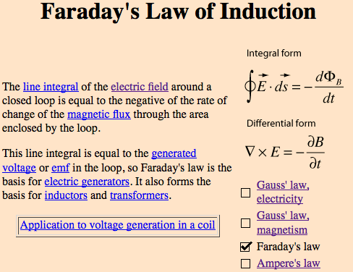

Slide 6
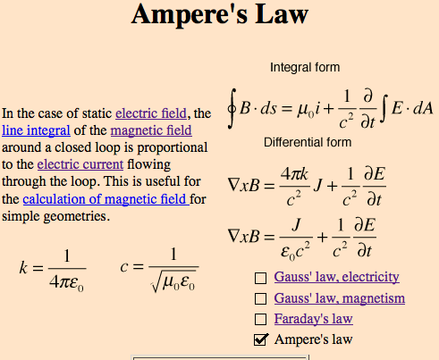

Slide 7
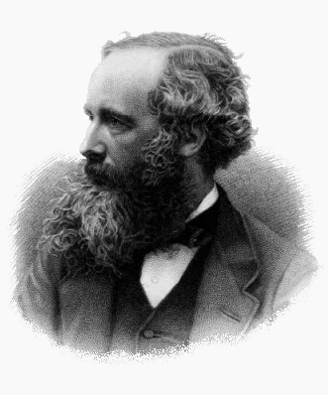
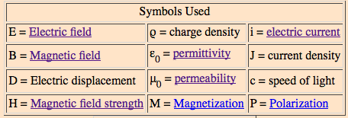
Maxwell’s Equations
James Clerk Maxwell (1831–1879)
One of the most concise ways to state the fundamentals of electricity and magnetism.
From them one can develop most of the working relationships in the field.
Form basis of Special Relativity, which requires that they hold in every frame of reference.

Slide 8
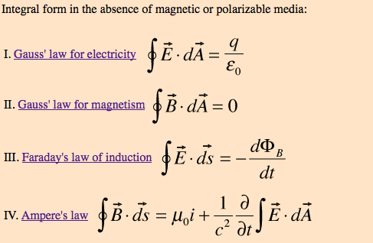
Maxwell’s equations (integral form)

Slide 9
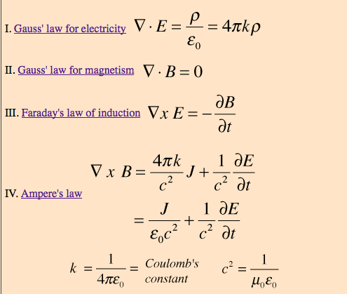
Maxwell’s equations (differential form)

