Slide 1
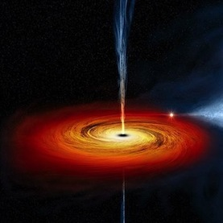

Black Holes
What are they?
Notes:
http://www.chandra.harvard.edu/graphics/resources/illustrations/blackholesStorm-72.jpg
1

Slide 2
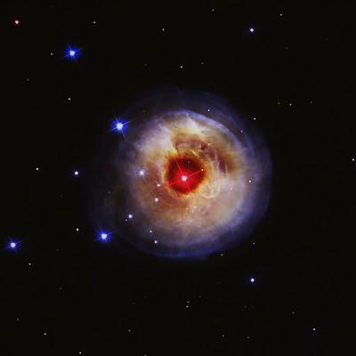
What is a star?
http://hubblesite.org/gallery/album/star/pr2004010c/
Stars are fusion reactors.
The fusion reactions try to tear the star apart
The star’s intense gravitational force tries to collapse the star.
There is a balance between these forces.
Notes:
Fusion is the fusing of two or more lighter atoms into a larger one; stars mostly convert Hydrogen to Helium in the core.
Extremely heavy stars (more than 25 times heavier than the Sun) have no means to withstand their own gravity as they die. They collapse completely to a black hole.

Slide 3
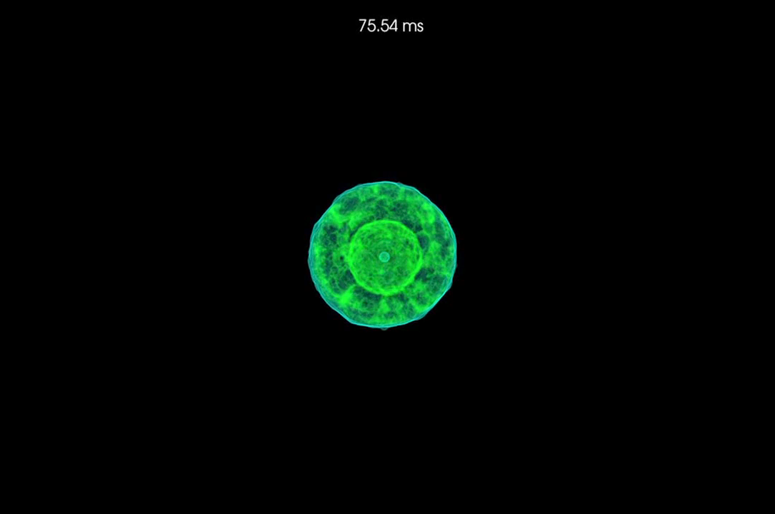
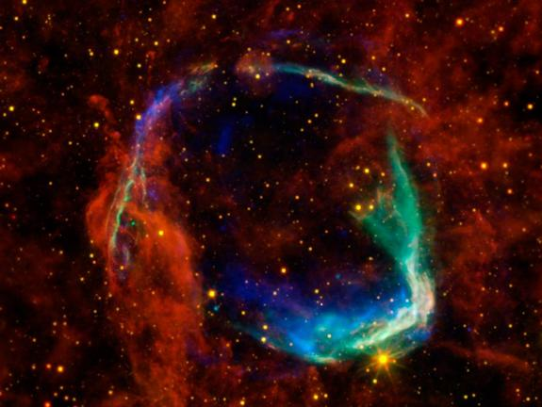
What happens when a star dies?
When the fuel for these reactions gets burned up the star dies…
Its gravity pulls everything inward, compresses the core, heating it up and causes a supernova explosion.
This creates a hole in spacetime.
Notes:
Because the core's gravity is so strong, the core sinks through the fabric of space-time, creating a hole in space-time and literally disappears from view. Not even light can escape it’s extreme gravitational forces.
Images courtesy of NASA/ESA/JPL-Caltech/UCLA/CXC/SA and X-ray: NASA/CXC/Rutgers/K.Eriksen et al.

Slide 4
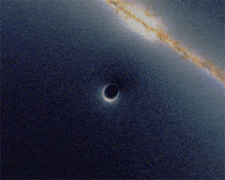
But how can we detect black holes?
1. Gravitational lens effects
2. From objects orbiting the black hole or spiralling into the core
3.Emitted radiation
"Black hole lensing web" by Urbane Legend (optimised for web use by Alain r) - en:Image:BlackHole_Lensing_2.gif
Notes:
4

Slide 5

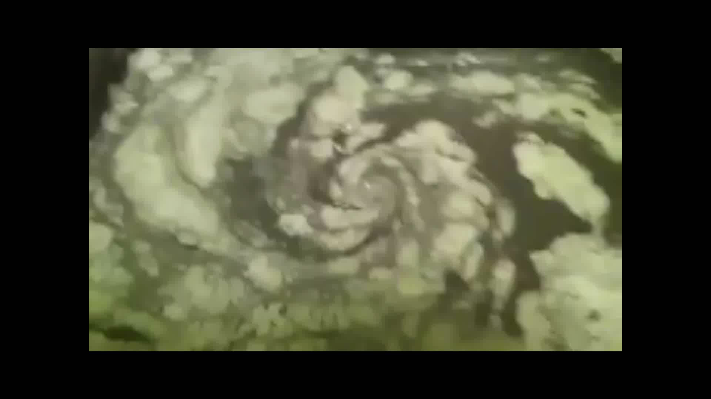
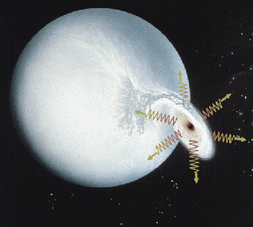
Objects spiralling
Emitted radiation
Notes:
Schematic of a black hole in a binary system, showing the accretion disk around the black hole and emission of X-rays
Photo courtesy CXC/S.Lee

Slide 6
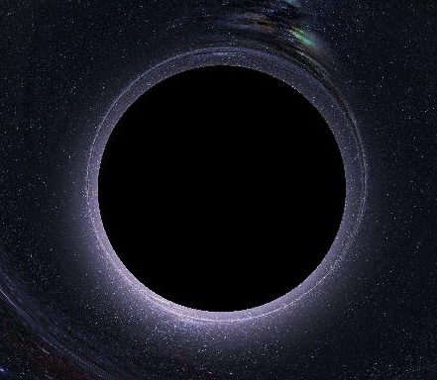
What happens to the stored potential energy of an object in space once it is sucked into a black hole?
And what form is that energy being converted into?

Slide 7
Wouldn’t that mean that there is an ‘accumulation’ of energy i.e. does this black hole contain within it a kind of ‘energy reservoir’?
Notes:
Yes , a large accumulation of energy = large accumulation of mass e=mc^2
So much mass in little space that gravitational force arising from object is so huge nothing escapes it’s grip, not even lighti.e you cannot see where it lies, there is only a black hole.( good example for explaining an event horizon)
This is where we come to the ‘Event horizon’ – boundary in spacetime beyond which events cannot effect an outside observer i.e the point of no return!

Slide 8
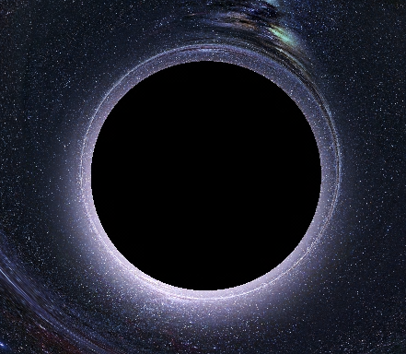
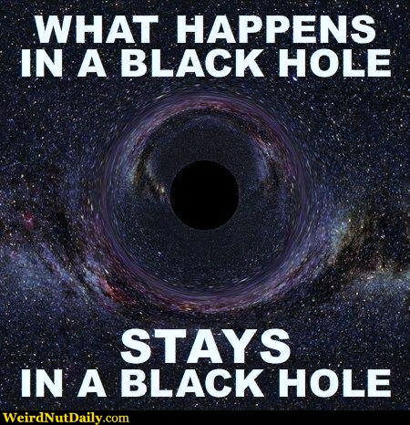

Slide 9
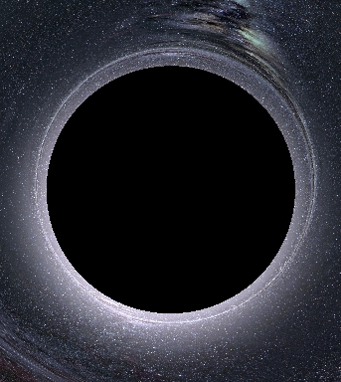
…Therefore, black hole theories state that:
A: There exists a singularity inside the black hole through which all matter is ‘crushed’ to a small point
B: Nothing can escape from the event horizon around a black hole
Can a black hole make matter ‘disappear’?
Where does it all go?
Notes:
A: as predicted by Einstein's gravity theory
Where does it all go? disappear? PARADOX ALERT
NO! Law in quantum theory states that information cannot just disappear!
..it is ‘CUT-OFF’ from us because no information can reach us from beyond the event horizon

Slide 10
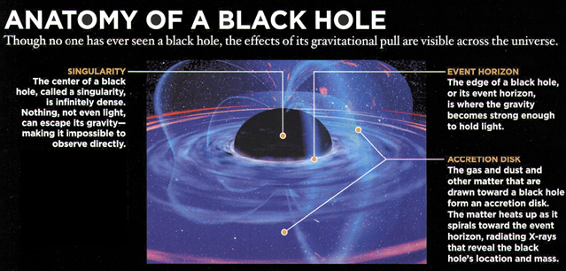
A single point called the ‘Singularity’
Notes:
http://www.crosswordfiend.com/blog/wp-content/uploads/2012/03/black_hole_anatomy.jpg

Slide 11

Thank you for your attention
Maria, Jean Paul, Daryl & Erica

